Slide 1
Course 3 – Different Types of Clinic Research Designs
Course 3 Different types of Clinical Research Designs
Copyright @ 2017 Ivy Research Link – Course 3

Slide 2
Objectives
Course 3 – Different Types of Clinic Research Designs
To learn about the main types of clinical research (study) designs.
To learn about advantages and disadvantages of each type of design
To be able to choose the right type of trial for your research project
Copyright @ 2017 Ivy Research Link – Course 3

Slide 3
What is clinical research?
Course 3 – Different Types of Clinic Research Designs
It is a branch of healthcare science that determines the safety and effectiveness of medications, devices, diagnostic products and treatment regimens intended for human use.
Every clinical investigation begins with the development of a clinical protocol.
The protocol is a document that describes how a clinical trial will be conducted (the objective(s), design, methodology, statistical considerations and structure of the clinical trial,) and ensures the safety of the trial subjects and integrity of the data collected.
Copyright @ 2017 Ivy Research Link – Course 3

Slide 4
Classifications of research trials
Course 3 – Different Types of Clinic Research Designs
There are different ways to classify research protocols.
One of the ways of classification is to classify into:
primary (includes collection of original primary data)
secondary (analysis and interpretation of data obtained by primary research)
Copyright @ 2017 Ivy Research Link – Course 3

Slide 5
Classification of trials, cont.
Course 3 – Different Types of Clinic Research Designs
Treatment vs. Observational studies
There is intervention in treatment trials comparing to different ways of observations in observational studies
Different types of studies are subject to different types of bias
Copyright @ 2017 Ivy Research Link – Course 3

Slide 6
Case Reports and Case series
Course 3 – Different Types of Clinic Research Designs
A report on a patient or series of patients with an outcome of interest.
No control group is involved.
Taber’s Cyclopedic Medical Dictionary’s definition of case report:
“A formal summary of a unique patient and his or her illness, including the presenting signs and symptoms, diagnostic studies, treatment course and outcome”
Historically case reports and series have been integral part of medical literature.
Copyright @ 2017 Ivy Research Link – Course 3

Slide 7
Case Reports and Case series, cont.
Course 3 – Different Types of Clinic Research Designs
Case report is a relatively low ranked in evidence hierarchy.
An advantage of case reporting is its ability to detect novelties.
Anything that is rare or has never been seen previously might be important for the medical community.
A case report or series may allow to formulate a new hypothesis which would guide the future research
Copyright @ 2017 Ivy Research Link – Course 3

Slide 8
Case reports and case series, cont.
Course 3 – Different Types of Clinic Research Designs
Some important case reports are described below:
The devastating side effects of thalidomide were first reported as a letter to the editor in the Lancet in 1996.
Alexander Fleming noticed a bacteria-free circle around the mold which led to discovery of penicillin.
There are multiple examples in history when a single observation and subsequent report eventually led to a big discovery.
Copyright @ 2017 Ivy Research Link – Course 3

Slide 9
Case reports and series, limitations
Course 3 – Different Types of Clinic Research Designs
Causality cannot be proven from single observation.
Findings from case reports cannot be generalized.
Publication bias as journals may look for positive findings.
Experiments cannot be repeated.
Copyright @ 2017 Ivy Research Link – Course 3

Slide 10
Cohort Study (Prospective Observational Study)
Course 3 – Different Types of Clinic Research Designs
A clinical research study in which people who presently have a certain condition or receive a particular treatment are followed over time and compared with another group of people who are not affected by the condition.
Copyright @ 2017 Ivy Research Link – Course 3

Slide 11
Prospective and retrospective cohort studies
Course 3 – Different Types of Clinic Research Designs
1. Prospective trials:
Here, at the time that the investigators begin enrolling subjects (people) and collecting baseline exposure information, none of the subjects has developed any of the outcomes of interest.
After baseline information is collected, subjects in a prospective cohort study are then followed "longitudinally," i.e. over a period of time, usually for years, to determine if and when they become diseased and whether their exposure status changes outcomes.
Copyright @ 2017 Ivy Research Link – Course 3

Slide 12
Prospective cohort studies
Course 3 – Different Types of Clinic Research Designs
Advantages:
- recall bias is minimized
- can evaluate multiple effects of a single exposure
- incidence can be measured directly
Disadvantages:
- need to follow large number of subjects for a long time
- can be expensive and time consuming
- not good for diseases which are rare and have long latency
- differential loss to follow up can introduce bias
Copyright @ 2017 Ivy Research Link – Course 3

Slide 13
Retrospective cohort studies.
Course 3 – Different Types of Clinic Research Designs
2. Retrospective trial
The investigators conceive the study and begin identifying and enrolling subjects after outcomes have already occurred.
It is performed post-hoc, as the cohort is followed retrospectively.
The time to complete a retrospective study is only as long as it takes to collect and interpret the data (much less than time required for prospective study)
Cheaper to perform this type of trials
Copyright @ 2017 Ivy Research Link – Course 3

Slide 14
Retrospective cohort studies, cont.
Course 3 – Different Types of Clinic Research Designs
Advantages:
- can be performed in short period of time
- potentially can address rare diseases
- cheaper to perform comparing to prospective studies
Disadvantages:
- data may be of poor quality
- it may be difficult to identify an appropriate exposed cohort and an appropriate comparison group
- different types of bias are more likely to occur
Copyright @ 2017 Ivy Research Link – Course 3

Slide 15
Case-control study
Course 3 – Different Types of Clinic Research Designs
Examines multiple exposures in relation to an outcome; subjects are defined as cases and controls, and exposure histories are compared.
Difference from retrospective cohort study: in case control investigator splits individuals by disease status whereas in retrospective cohort, investigator splits study individuals by their exposure status.
Copyright @ 2017 Ivy Research Link – Course 3

Slide 16
Systematic review
Course 3 – Different Types of Clinic Research Designs
This is a summary of the clinical literature.
A systematic review is a critical assessment and evaluation of all research studies that have been published and addresses a particular clinical issue.
The researchers use an organized method of locating, assembling, and evaluating a body of literature on a particular topic using a set of specific criteria.
A systematic review typically includes a description of the findings of the collection of research studies. The systematic review may also include a quantitative pooling of data, called a meta-analysis.
Copyright @ 2017 Ivy Research Link – Course 3

Slide 17
Systematic review, cont.
Course 3 – Different Types of Clinic Research Designs
Advantages:
- can help reader to review large amount of data in a short period of time.
- conclusions of reviews are in general more reliable than those of individual studies
Disadvantages:
- unpublished studies will not be included and this may be a source of bias
Copyright @ 2017 Ivy Research Link – Course 3

Slide 18
Steps in performing systematic review
Course 3 – Different Types of Clinic Research Designs
Step 1: Framing questions for a review.
The problems to be addressed by the review should be specified in the form of clear, unambiguous and structured questions before beginning the review work.
Once the review questions have been set, modifications to the protocol should be allowed only if alternative ways of defining the populations, interventions, outcomes or study designs become apparent.
Copyright @ 2017 Ivy Research Link – Course 3

Slide 19
Systematic review. Step 2.
Course 3 – Different Types of Clinic Research Designs
Step 2: Identifying relevant work.
The search for studies should be extensive. Multiple resources (both computerized and printed) should be searched without language restrictions.
The study selection criteria should flow directly from the review questions and be specified a priori. Reasons for inclusion and exclusion should be recorded.
Copyright @ 2017 Ivy Research Link – Course 3

Slide 20
Systematic review. Step 3.
Course 3 – Different Types of Clinic Research Designs
Step 3: Assessing the quality of studies.
Study quality assessment is relevant to every step of a review.
Question formulation and study selection criteria should describe the minimum acceptable level of design.
Selected studies should be subjected to a more refined quality assessment by use of general critical appraisal guides and design-based quality checklists.
These detailed quality assessments will be used for exploring heterogeneity and informing decisions regarding suitability of review.
In addition they help in assessing the strength of inferences and making recommendations for future research.
Copyright @ 2017 Ivy Research Link – Course 3

Slide 21
Systematic review. Step 4.
Course 3 – Different Types of Clinic Research Designs
Step 4: Summarizing the evidence.
To summarize the evidence from studies of variable design and quality is not easy.
Data synthesis consists of tabulation of study characteristics, quality and effects.
If you perform meta-analysis you should also use of statistical methods for exploring differences between studies and combining their effects.
Copyright @ 2017 Ivy Research Link – Course 3

Slide 22
Systematic review. Step 5.
Course 3 – Different Types of Clinic Research Designs
Step 5: Interpreting the findings.
The elaborate efforts in searching an unusually large number of databases provide some safeguard against missing relevant studies.
Copyright @ 2017 Ivy Research Link – Course 3

Slide 23
Meta-analysis
Course 3 – Different Types of Clinic Research Designs
A way of combining data from many different research studies.
A meta-analysis is a statistical process that combines the findings from individual studies.
A type of systematic review which uses statistical methods to summarize the results of the studies.
Copyright @ 2017 Ivy Research Link – Course 3

Slide 24
Randomized controlled trial (RCT).
Course 3 – Different Types of Clinic Research Designs
A controlled clinical trial that randomly (by chance) assigns participants to two or more groups. There are various methods to randomize study participants to their groups.
These studies are designed to minimize bias.
Copyright @ 2017 Ivy Research Link – Course 3

Slide 25
RCT, cont.
Course 3 – Different Types of Clinic Research Designs
Advantages of RCT
- ability to make causal inferences mean that RCT provide the strongest empirical evidence of a treatment's efficacy.
- randomization of participants to the test and control arms and concealment of their allocation ensures that allocation bias and confounding of unknown variables are minimized.
- the study can be tailored to answer a specific research question.
Disadvantages of RCT
- high dropout rate when the intervention has undesirable side-effects or there is little incentive to stay in the control arm.
- ethical considerations may mean that a research question cannot be investigated using the RCT design.
- for a descriptive overview it may be cheaper and easier to use an observational design.
- prior knowledge is required about the level of improvement that is clinically meaningful and the expected variation of improvement in the sample in order to calculate the RCT sample size. These facts are often not known.

Slide 26
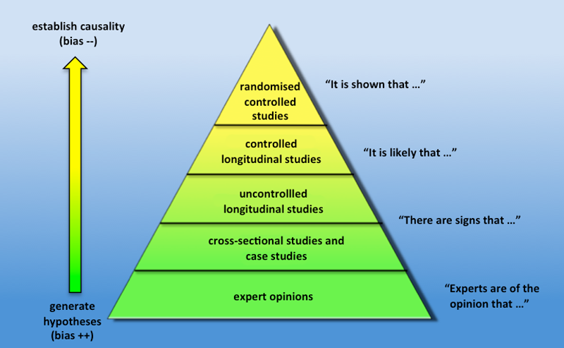
Levels of evidence
Course 3 – Different Types of Clinic Research Designs
Copyright @ 2017 Ivy Research Link – Course 3

Slide 27
Summary
Course 3 – Different Types of Clinic Research Designs
There are many types of study designs.
The most popular research design protocols are case reports, cohort studies, systematic reviews including meta-analysis and randomized controlled trials.
Each of them has its own advantages and disadvantages. These should be taken into account while choosing the research protocol.
There is hierarchy of levels of evidence with randomized controlled trials and systematic reviews providing the highest level of evidence.
Copyright @ 2017 Ivy Research Link – Course 3

Slide 28
Course 3 – Different Types of Clinic Research Designs
Course 3 Different types of Clinical Research Designs
Copyright @ 2017 Ivy Research Link – Course 3

