Slide 1
Course 4 Characteristics of the test
Course 4 – Characteristics of the test
Copyright @ 2017 Ivy Research Link – Course 4

Slide 2
Objectives
Course 4 – Characteristics of the test
To understand the characteristics of the test
To understand sensitivity, specificity, positive and negative predictive value
To be able to apply this knowledge to clinical practice and making evidence-based decisions.
Copyright @ 2017 Ivy Research Link – Course 4

Slide 3
Introduction
Course 4 – Characteristics of the test
The current course is essential for every-day practice.
Every student involved in science should have knowledge about the characteristics of a test and be able to evaluate the meaningfulness of a test.
The diagnostic power of any test is determined by both its sensitivity and its specificity
Copyright @ 2017 Ivy Research Link – Course 4

Slide 4
Sensitivity
Course 4 – Characteristics of the test
Sensitivity of a test is the proportion of positives that are identified as positives.
A test that is 100% sensitive will identify all patients who have the disease.
100% sensitivity can be achieved by loosing specificity and although all positives will be identified some positive tests will be false positive.
It is important to have highly sensitive test if you need a screening tool. False positives can be identified at the 2nd step by highly specific test.
Copyright @ 2017 Ivy Research Link – Course 4

Slide 5
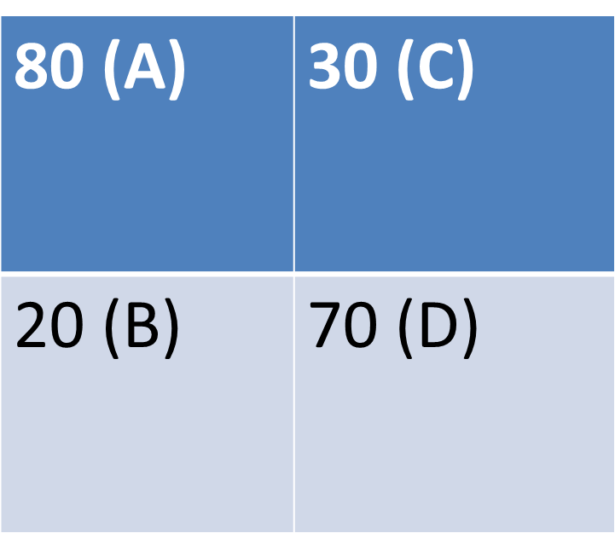
Sensitivity calculation
Course 4 – Characteristics of the test
Disease
+ -
+
Test
-
Sensitivity= A ÷(A+B) = 80÷(20+80)=0.8=80%
Copyright @ 2017 Ivy Research Link – Course 4

Slide 6
Specificity
Course 4 – Characteristics of the test
Specificity of a test is the proportion of negatives that are correctly identified as negatives.
This means that if the test is highly specific and positive it is likely to be truly positive.
It is important to confirm the diagnosis with highly specific test before treatment, especially if the treatment is toxic
Copyright @ 2017 Ivy Research Link – Course 4

Slide 7
Specificity calculation
Course 4 – Characteristics of the test
Disease
+ -
+
Test
-
Specificity= D ÷(C+D) = 70÷(30+70)=0.7=70%
Copyright @ 2017 Ivy Research Link – Course 4

Slide 8
Positive predictive value (PPV)
Course 4 – Characteristics of the test
This is for you to be able to determine if a positive test result means that a patient really have the disease or not.
For example, if someone tests for hepatitis C and it comes back positive and the PPV = 99% , then the probability of the patient having hepatitis C is 99%
PPV is a proportion of positive tests that are truly positive.
Remember that PPV, unlike sensitivity and specificity, depends on prevalence.
In a community where nobody has the disease PPV will be equal to zero.
Copyright @ 2017 Ivy Research Link – Course 4

Slide 9
PPV calculation
Course 4 – Characteristics of the test
Disease
+ -
+
Test
-
PPV= A ÷(A+C) = 80÷(80+30)=0.727=72.7%
Copyright @ 2017 Ivy Research Link – Course 4

Slide 10
Negative predictive value (NPV)
Course 4 – Characteristics of the test
This is the probability of a patient not having a disease after a negative test.
For example, if a patient tests for HIV and it is negative and the NPV is 99% - then negative test means that the patient does not have HIV with 99% probability.
Similar to PPV - NPV also depends on prevalence of the disease in population.
Copyright @ 2017 Ivy Research Link – Course 4

Slide 11
NPV calculation
Course 4 – Characteristics of the test
Disease
+ -
+
Test
-
NPV= D ÷(B+D) = 70÷(70+20)=0.77=77%
Copyright @ 2017 Ivy Research Link – Course 4

Slide 12
Likelihood ratio (LR)
Course 4 – Characteristics of the test
The Likelihood Ratio (LR) is the likelihood that a given test result would be expected in a patient with the target disorder compared to the likelihood that that same result would be expected in a patient without the target disorder.
The LR is used to assess how good a diagnostic test is and to help in selecting an appropriate diagnostic test.
Copyright @ 2017 Ivy Research Link – Course 4

Slide 13
Likelihood ratio and Chance
Course 4 – Characteristics of the test
Chance can be expressed either as a probability or as the odds ratio.
Most people tend to feel more comfortable using probabilities than odds ratio, but that is a matter of training and preference, and not logic.
To use LR we need to know odds ratio rather than probability and we should be comfortable converting odds to probability and vice versa.
Copyright @ 2017 Ivy Research Link – Course 4

Slide 14
Odds and Probability
Course 4 – Characteristics of the test
The probability that an event will occur is the fraction of times you expect to see that event in many trials. Probabilities always range between 0 and 1 (0 to 100%)
The odds are defined as the probability that the event will occur, divided by the probability that the event will not occur.
Copyright @ 2017 Ivy Research Link – Course 4

Slide 15
Odds and Probability, cont.
Course 4 – Characteristics of the test
A probability of 0 is the same as odds of 0.
Probabilities between 0 and 0.5 equals odds less than 1.0.
A probability of 0.5 is the same as odds of 1.0.
Think of it this way: The probability of flipping a coin to heads is 50%. The odds are “fifty: fifty,” which equals 1.0.
As the probability goes up from 0.5 to 1.0, the odds increase from 1.0 to approach infinity. For example, if the probability is 0.75, then the odds are 75:25, three to one, or 3.0.
If the odds are high (million to one), the probability is almost 1.00.
If the odds are tiny (one to a million), the probability is tiny, almost zero.
Copyright @ 2017 Ivy Research Link – Course 4

Slide 16
Odds and Probability conversion
Course 4 – Characteristics of the test
To convert from a probability to odds: divide the probability by one, and subtract that probability.
Thus, if the probability is 10% or 0.10 , then the odds are 0.1/0.9, or ‘1 to 9’, or 0.111.
To convert from odds to a probability: divide the odds by one, and add the odds.
Thus, to convert the odds of 1/9 to a probability: divide 1/9 by 10/9 to obtain the probability of 0.10.
Copyright @ 2017 Ivy Research Link – Course 4

Slide 17
Likelihood ratio, example
Course 4 – Characteristics of the test
So, let’s assume that the probability of a patient having a disease, for example Lyme disease, is 90% based on the clinical presentation. This will convert to an odds of 9 (0.9 ÷ (1 - 0.9) = 9).
Lets assume that a positive LR of the test is 3 (positive LR is used if the test comes back positive).
Then a positive test will increase the pre-test odds of 9 to 27 (9 * 3 = 27). This will convert to the post-test probability of 96.4% (27 ÷ (1 + 27) = 0.964 = 96.4%)
Thus, the probability of Lyme disease went from 90% to 96.4%.
Copyright @ 2017 Ivy Research Link – Course 4

Slide 18
Likelihood ration: an example
Course 4 – Characteristics of the test
Let’s assume a negative LR for the same test of Lyme disease is 0.4.
Let’s take a look at LR of Lyme disease if the test comes back positive:
→ 9 * 0.4 = 3.6
This will convert to the probability of 78.26% (3.6 ÷ (1 + 3.6) = 0.7826 = 78.26%)
Copyright @ 2017 Ivy Research Link – Course 4

Slide 19
Likelihood ration, example
Course 4 – Characteristics of the test
Consequently, what we see here is that probability changes from 90% to 96.4% with positive test and from 90% to 78.26% with negative test.
In both situation the decision will be to treat Lyme disease as the treatment is relatively benign (typically a short course of doxycycline).
These examples also show that tests should always be ordered thoughtfully, and should not be ordered at all if the result will not change the ultimate decision making about the treatment or intervention.
Copyright @ 2017 Ivy Research Link – Course 4

Slide 20
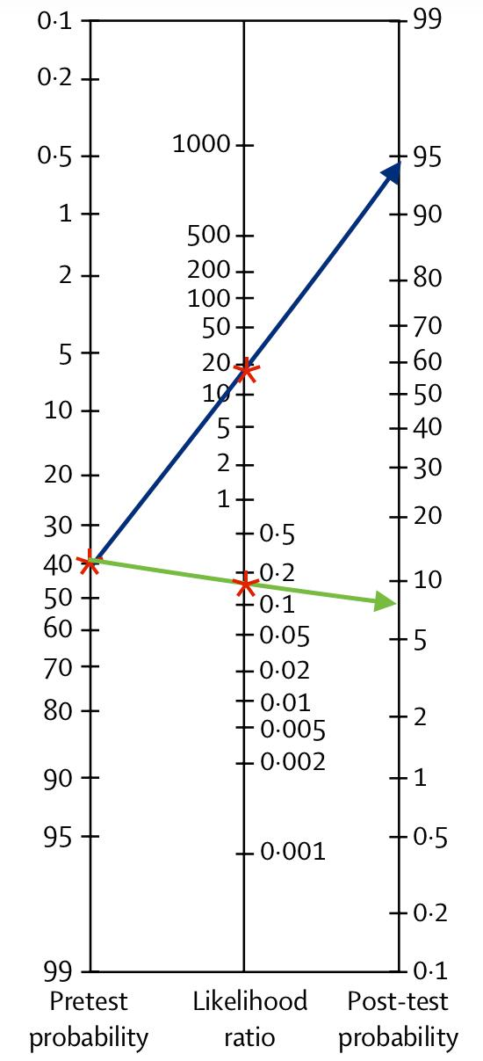
LR nomogram
Course 4 – Characteristics of the test
A nomogram can be used
as a quick tool to calculate
post-test probability if you
have pre-test probability
and LR.
Copyright @ 2017 Ivy Research Link – Course 4

Slide 21
Summary
Course 4 – Characteristics of the test
The above characteristics of the test including sensitivity, specificity, PPV, NPV and LR are very important concepts which one practicing or learning medicine should know.
High sensitivity means all positives will test positive and negative result will likely be truly negative and good to rule out.
High specificity means all negatives will test negative and positive result will highly suggest the tested pathology.
Positive and negative predictive values show the probability of a person having or not having a disease after the test returns positive or negative, respectively.
Understanding the concept will help to order the right tests and to avoid unnecessary testing.
Copyright @ 2017 Ivy Research Link – Course 4

Slide 22
Course 4 Characteristics of the test
Course 4 – Characteristics of the test
Copyright @ 2017 Ivy Research Link – Course 4

